Slide 1
How Junction Information can help Predict Accident Severity
Hugh Chua

Slide 2
How Junction Information Could be useful
Traffic accidents kill 1.35mil people a year; cost most countries 3% of their GDP
Vehicles are thought to get into car accidents when crossing junctions
Therefore need to investigate this
Help Drivers make decisions to stay away from traffic blackspots
Help NGOs develop safer roads for economically less developed countries

Slide 3
Data and Feature Selection
Dataset from Kaggle: (https://www.kaggle.com/akshay4/road-accidents-incidence)
Traffic Accidents in the UK 1979-2015
From Open Data Platform UK
Selected Features: Accident Severity, Road Type, Junction Detail, Junction Control, Light Condition, Weather Conditions, Special Conditions at Site, Urban or Rural Area, Day of the Week
Two datasets created (df1, df2)
Df1: data without junction information
Df2: dta with junction information

Slide 4
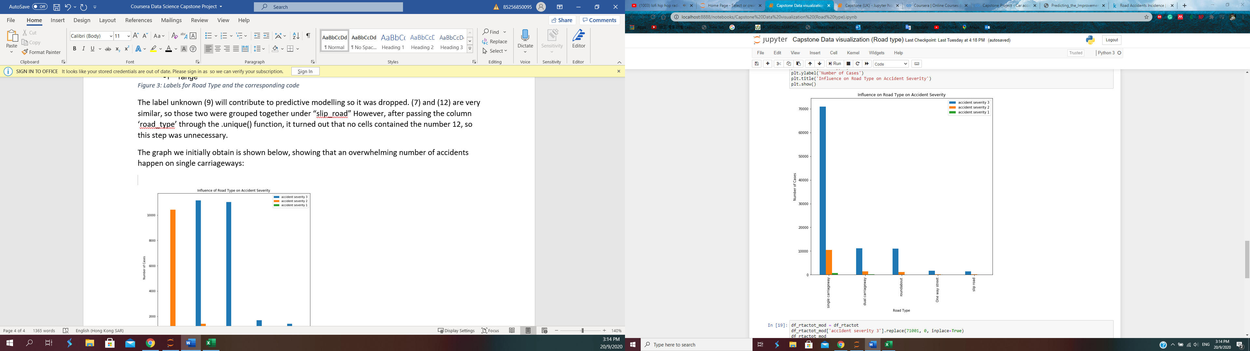
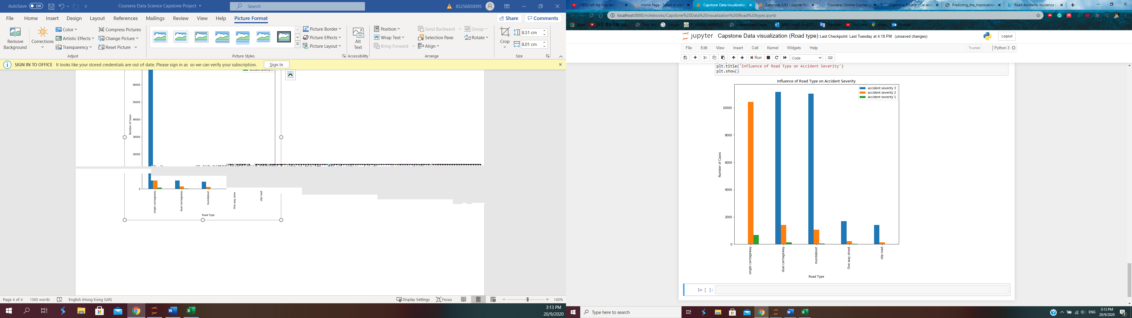
Road Type
Main Takeaway: Most accidents happen on Single Carriageways; likely because it links larger highways to smaller roads

Slide 5
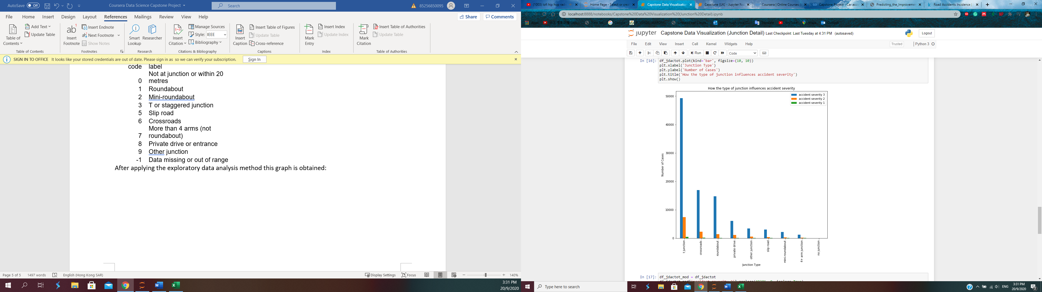
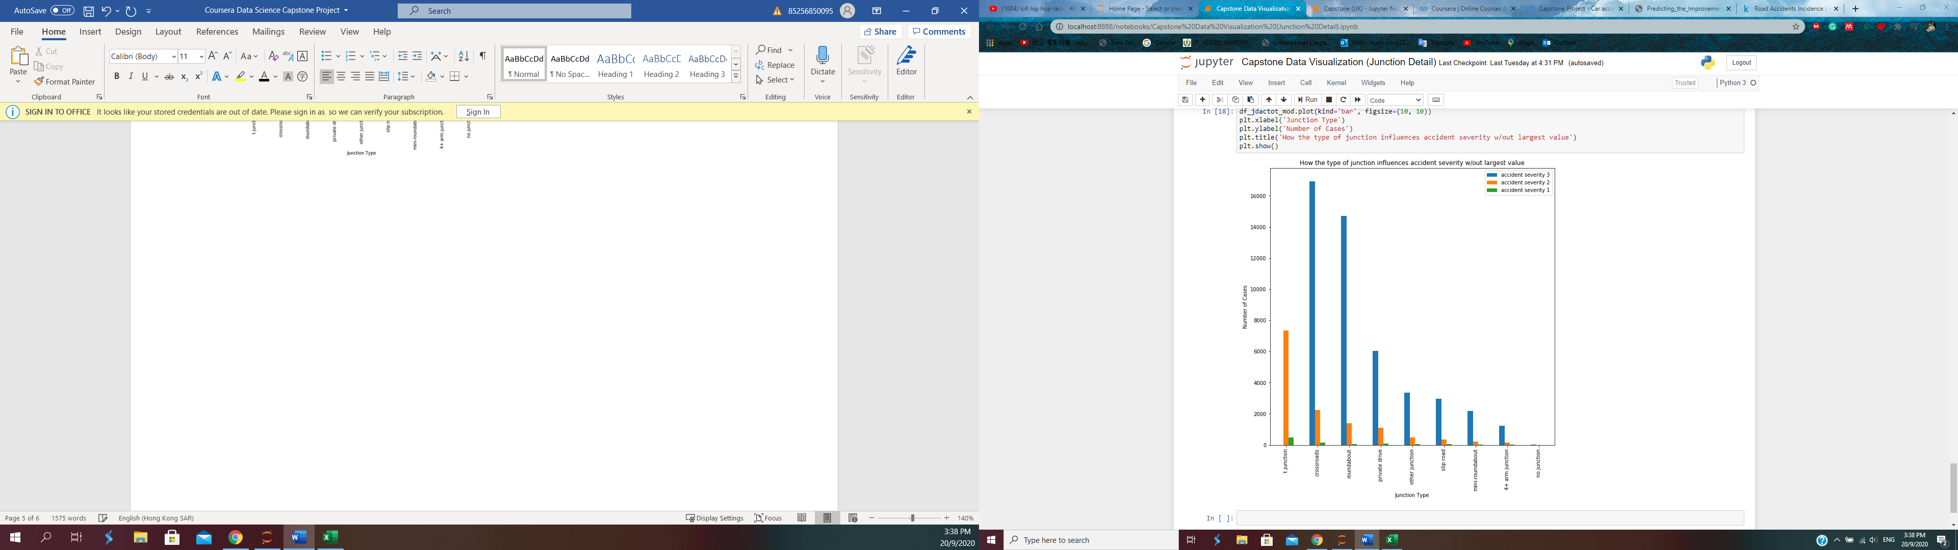
Junction Detail
Main takeaway:
- T junctions, Roundabouts, and Crossroads have the most accidents
- Extremely few accidents happen far away from a junction

Slide 6
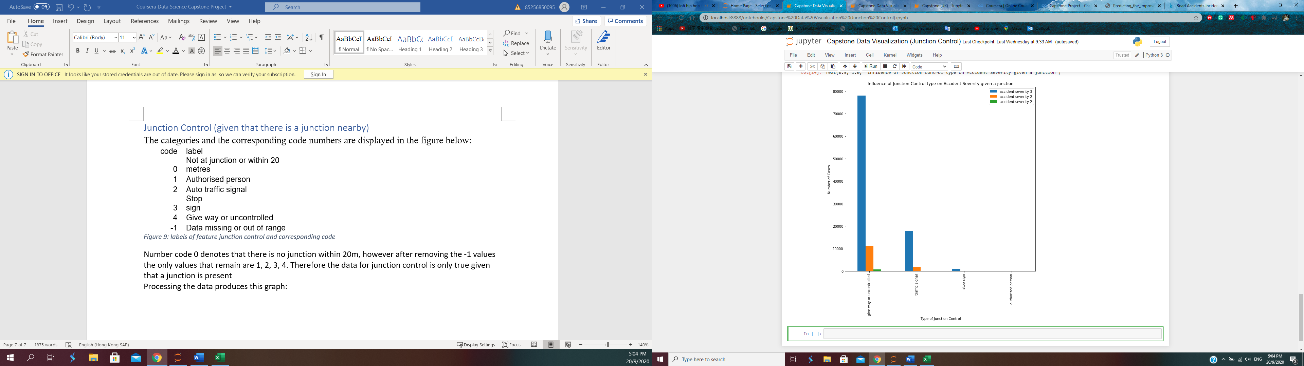
Junction Control
Main Takeaway:
- Most accidents occur when there is no active form of traffic control, such as traffic lights, stop signs, etc

Slide 7
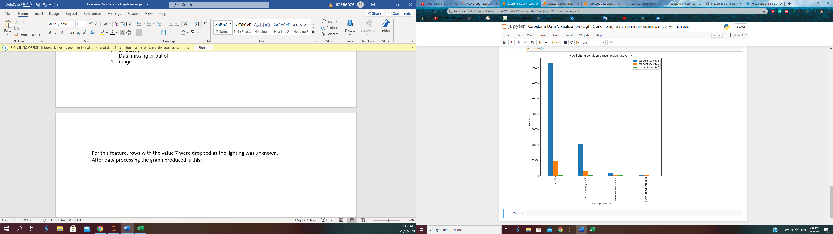
Light Conditions
Main Takeaways:
Most accidents occur under lighted conditions; majority of roads have lighting
Light Conditions not a large factor

Slide 8
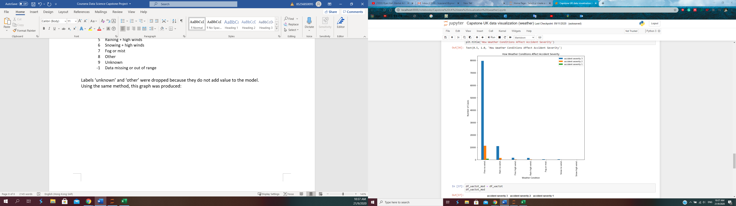
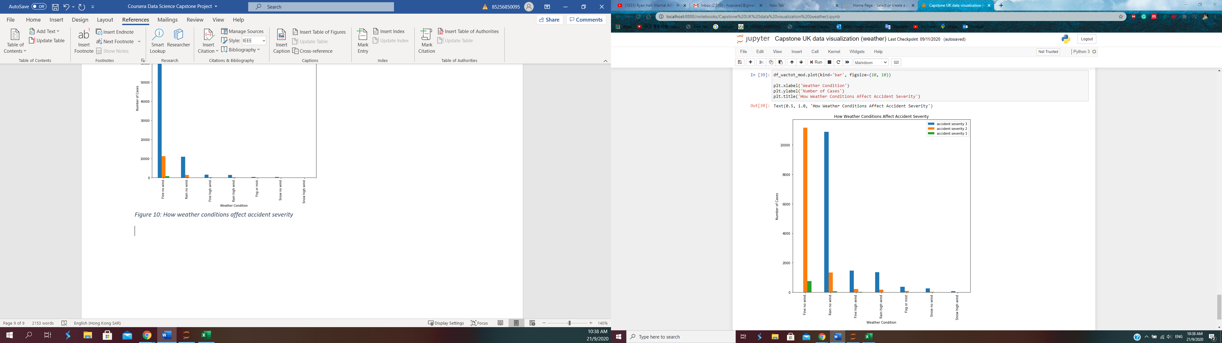
Weather Conditions
Main Takeaways:
Most Accidents in fine conditions
Possible Explanation: When weather conditions are bad drivers are more careful

Slide 9
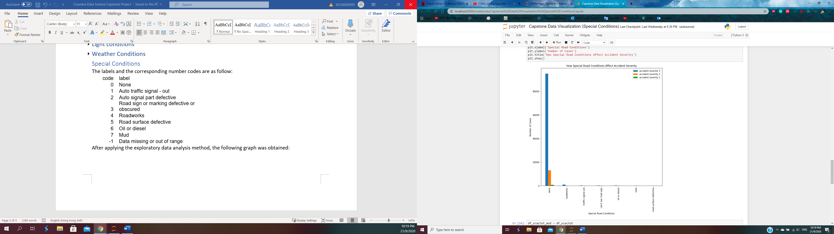
Special Conditions
Main Takeaways:
- Very few accidents happen due to: roadworks, faulty traffic light, oil/diesel, mud, defective road surface, obstructed vision to road sign

Slide 10
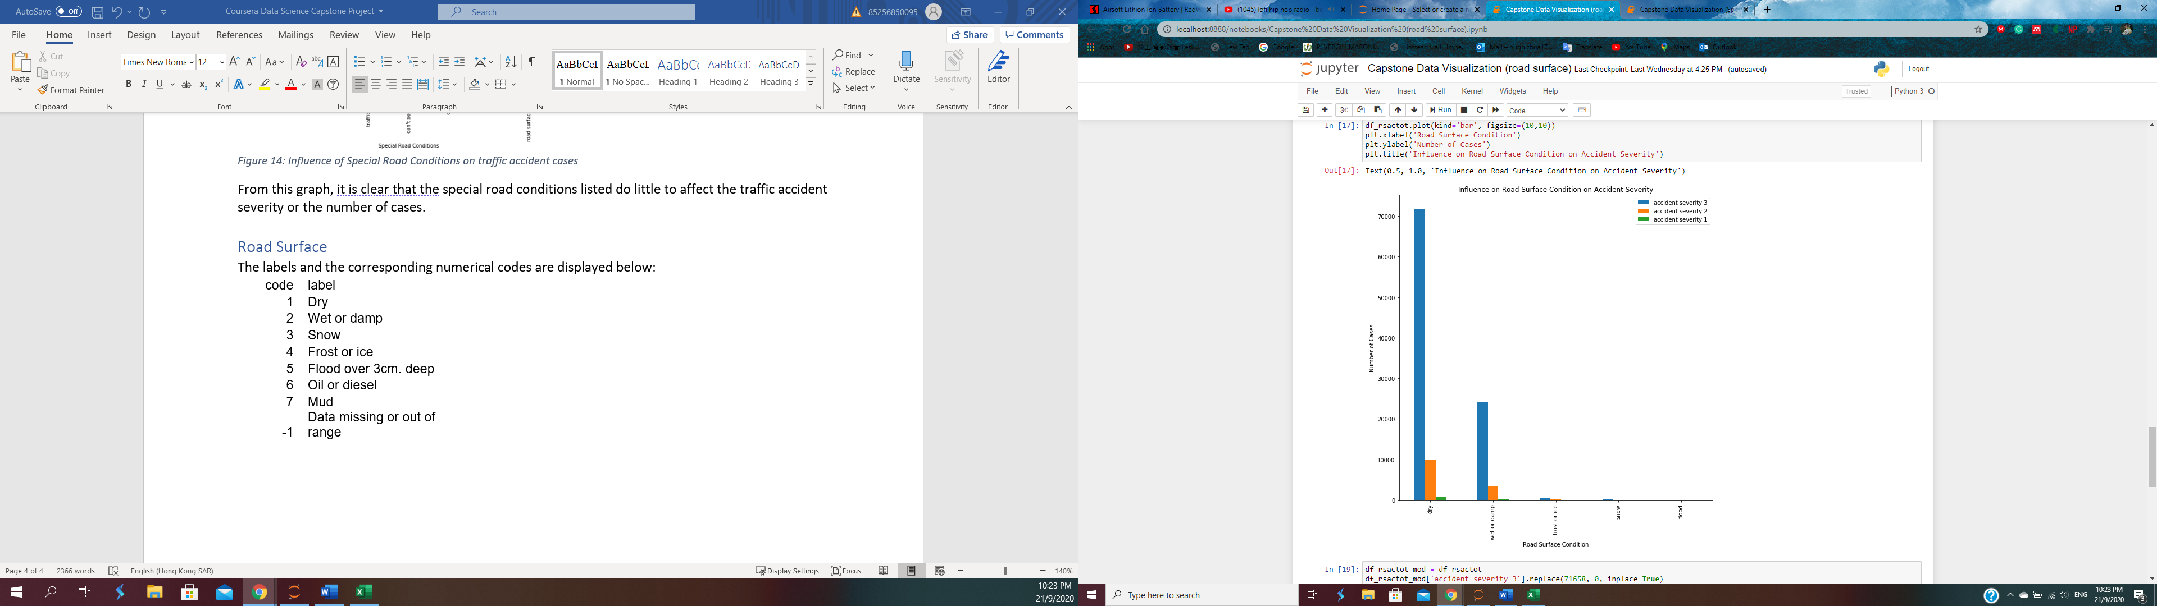
Road Surface
Main Takeaways:
Most accidents occur under dry conditions
However, wet or damp surface play a significant role in accidents

Slide 11
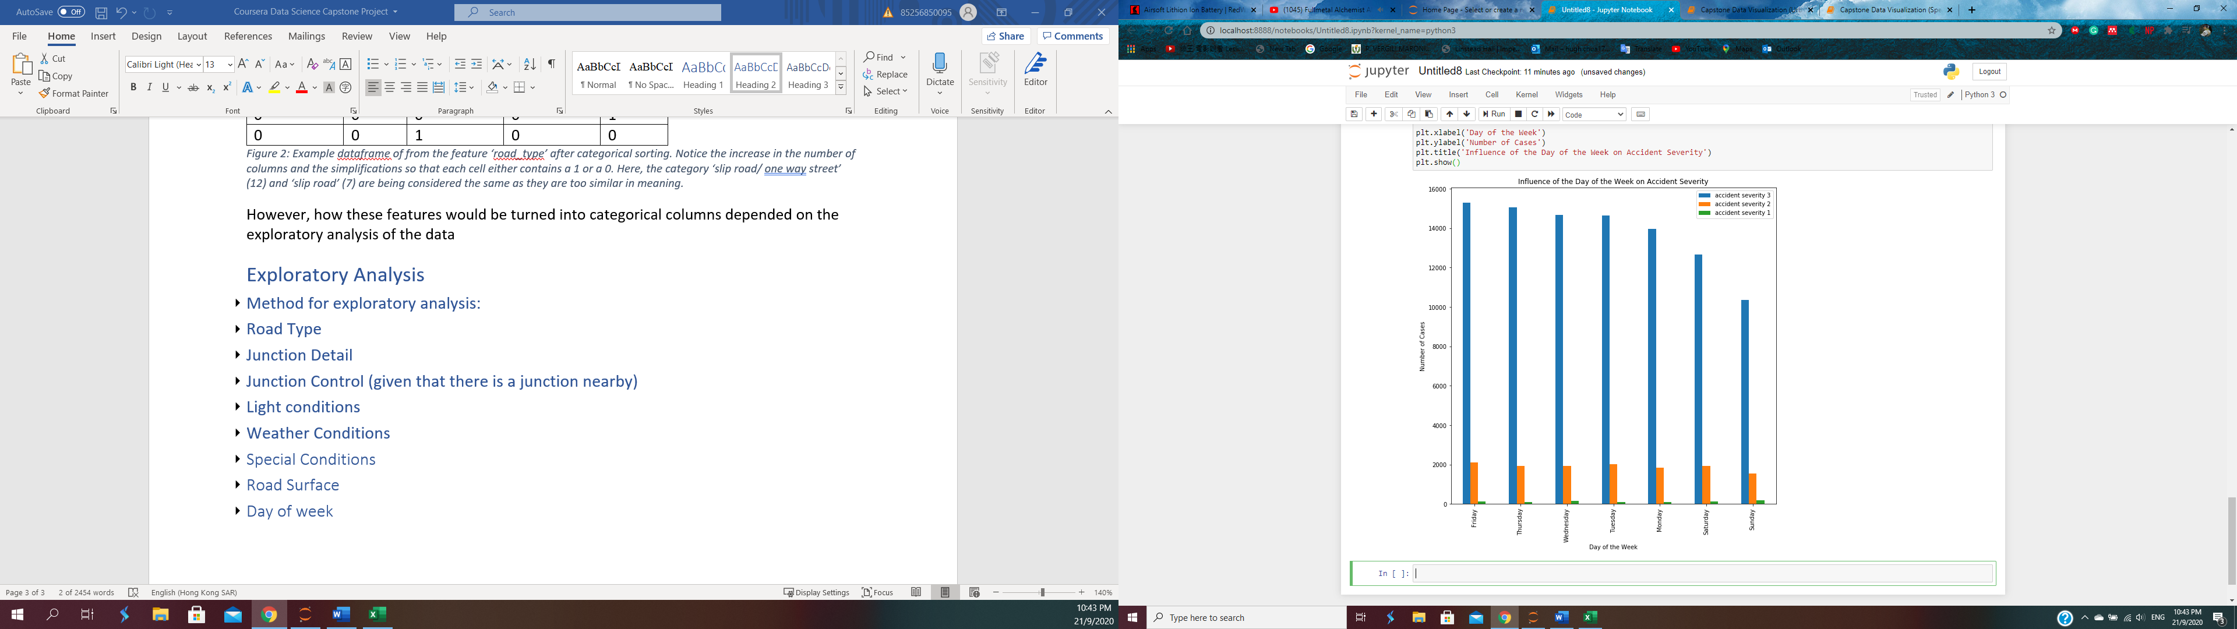
Day of the Week
Main Takeaways:
Less accidents happen on the weekend (Saturday and Sunday)
Most accidents happen on Friday
Monday thru Thursday have roughly the same number of accidents
Sunday has the largest amount of fatal accidents
Possible: weekend drivers

Slide 12

Urban or Rural
Main Takeaways:
More accidents happen in urban environments
Slightly more fatal accidents in rural areas

Slide 13
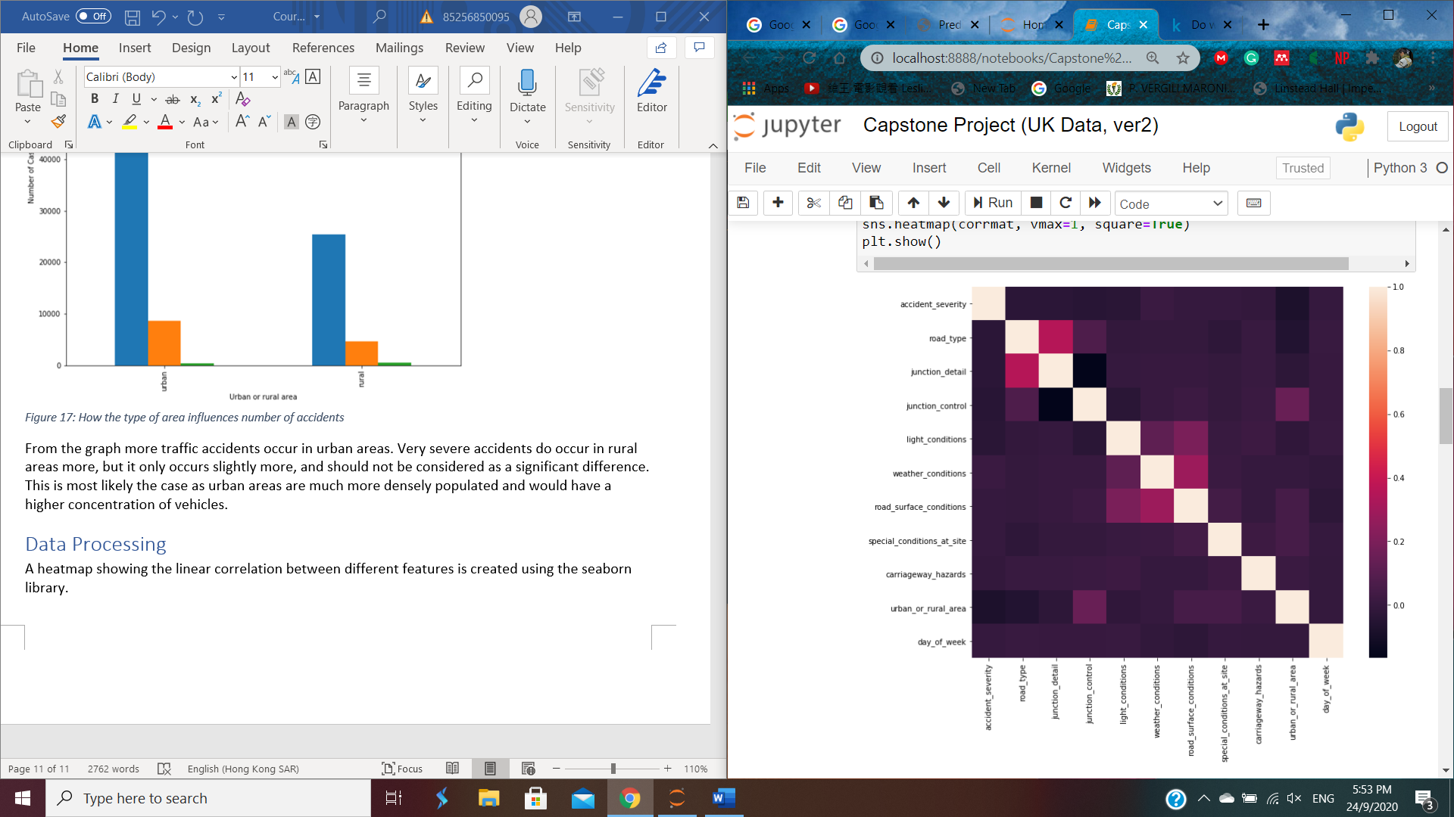
Data Processing
From exploratory analysis, Junction Detail and Junction Control have a large impact on number of accidents and accident severity
Heatmap shows little linear correlation between features; linear machine learning models not necessary

Slide 14
Predictive Modelling
Df1 and df2 are further split into 2 more datasets. One set used for finding best machine learning settings; the other used to check data
Machine Learning Models Used:
K Nearest Neighbors
Decision Tree
Support Vector Machine
Logistic Regression

Slide 15
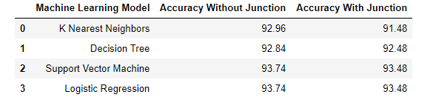
Results + Future Improvements
Accuracy has not increased when the junction data is added
Likely because model has lots of data to work with
Did not need junction data to predict accident severity
Things to do in the Future:
Different Machine Learning models e.g. random forest, gradient boost
Maybe more data could be used (More rows of data)
Explore different attributes e.g. Age of driver, Age of vehicle

